Slide 1
What Dale Carnegie’s Principles Suggest for Evaluation
Kathryn Race
Race & Associates, Ltd.
4430 N. Winchester Ave
Chicago, IL
race_associates@msn.com
Notes:
Kathryn Race and Race & Associates, Ltd. are not affiliated with Dale Carnegie Training. The views presented here are those of the author and do not necessarily represent the views of Dale Carnegie Training.

Slide 2
Purpose
Discuss how Dale Carnegie’s principles on interpersonal skills, as presented in his book How to Win Friends & Influence People, can enhance evaluation practice.
Carnegie, D. (1936). How to win friends & influence people. New York: Galahad.
Revised edition Carnegie, D. D. & Carnegie, D. (1981).
Notes:
A few biographical notes about Dale Carnegie (1888-1955). First, he was not related to the philanthropist Andrew Carnegie (1835-1919). In fact, the original spelling of his last name was Carnagey, which he changed around 1922. He was a writer, lecturer and the developer of famous courses (including self-improvement, salesmanship, corporate training, public speaking, and interpersonal skills). His book, How to Win Friends and Influence People was first published in 1936 and is the focal point of this presentation. Both men knew poverty as young children. Dale was born into poverty on a farm in Missouri; and Andrew’s family came to the United States from his native Scotland during an economic depression, where his father’s handloom business succumbed to competition from the Industrial Revolution. I will focus on those principles that I think most resonate with the practice of evaluation.

Slide 3
Not Friends but Respected Colleagues
Principles are discussed within the context of conducting quality evaluations and maintaining the integrity of the work
Recognize and respect our own expertise and professional skills in the conduct of evaluation but seek to see things from the perspective of others (e.g., clients, major stakeholders, funder)
Notes:
Not friends but perhaps a “critical friend.” These principles are intended to be used in authentic and genuine ways in pursuit of evaluation of high quality and integrity. At no point, do I intend to imply that the integrity of the evaluation be compromised. No one is advocating for the used car salesman’s approach.

Slide 4
Principles Are
Used as a spring board through which examples and suggested evidence are presented from various sources

Slide 5
How Would You Rate …
The relative importance of professional vs. interpersonal skills …
Perhaps think in terms of interpersonal skills as a “value-added” to our professional skills
Or, perhaps an integral part
Notes:
There are times when professional skills are contrasted with interpersonal skills as somehow these are “either or” skills and not a set of skills where both need to be present. How do good interpersonal skills help our evaluation, building a client base, etc.? If we define professional skills to mean technical skills plus business acumen, time management skills, etc. then perhaps we ought to think of interpersonal skills as an integral part of our professional skills.

Slide 6
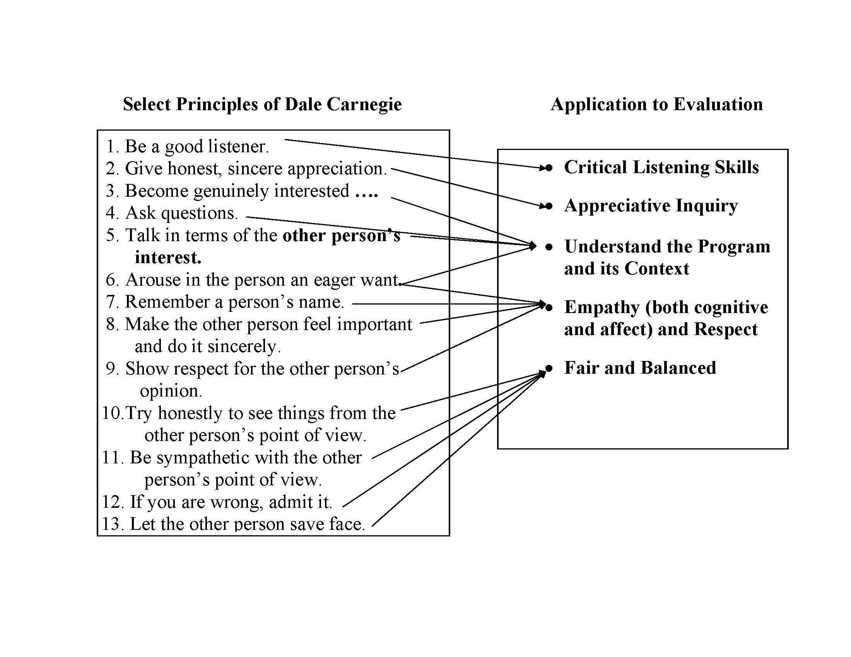
Notes:
Here is an overview of the connections that I see between these principles and their application to evaluation practice. There are more Dale Carnegie principles presented in his book than are presented here; these are ones that I thought resonant in evaluation practice and in dealing with stakeholders. Some of these principles link to the American Evaluation Association Principles especially relative to respecting stakeholders, clients, funders or other evaluators. Perhaps here we are extending this thought a bit to include both the cognitive and affect components of empathy. Respecting our objectivity I am not suggesting advocacy. Also regarding number 12. If you are wrong, admit it. I mean to suggest this in informal ways; not in any way that might have legal ramifications.

Slide 7
Some Connections Seem Essential
Be a good listener
Give honest sincere
appreciation
Fair and Balanced Approach
Critical listening skills
What’s working; what’s not

Slide 8
Some Connections Seem Essential
Genuinely interested
Ask questions
Talk in terms of the
other person’s interest
Understand the Program and its Context
Fair and Balanced Approach
Notes:
Understanding the program (and a solid sense of the context in which the program operates) is essential to designing an evaluation which seeks to assess merit and worth. I use a fully articulated program model to help guide our thinking and to help facilitate a common understanding of the program among stakeholders and the evaluator (Donaldson, 2007).

Slide 9
Examples
Notes:
Remember to find you own style; interact with clients and stakeholders in a respectful manner that is sincere and authentic. If a particular principle or style doesn’t work for you or represent who you are then don’t try it.

Slide 10
Ask Questions
Don’t be afraid to ask questions….preface your questions.
Especially if these are likely to sound confrontational. For example,
“I apologize if this question sounds pointed but” ...
Or to help clarify ….
“Help me understand” …..
“Let me feed back to you what I think I just heard”…
“My understanding is” …
“Have I gotten that right” …..
Notes:
Maybe this seems obvious but …

Slide 11
Ask Questions
Prefacing your questions will help your listener
understand why you are asking the question
Asking questions will give the impression (and
rightly so) that you are interested in the program
And will likely help your understanding of the
program and its context
Hard to evaluate well an evaluand that one does
not fully understand
Don’t be afraid of asking basic questions; the
obvious can be the hardest to see at times
Notes:
I have found that prefacing your question with the rationale behind the question can soften the pointed nature of it ; the preface can take the edge off perhaps help to defuse the tension and help avoid folks getting defensive. Remember the obvious can be hard to see at times and the basics at times can be even harder to see.

Slide 12
Remember a Person’s Name
Focus Group Example:
I follow the guidelines suggested by Richard
Krueger (Krueger & Casey, 2008)
But as part of the ice-breaker question, I ask
participants to state his or her first name
I draw a “seating chart” on my note pad
I explain why I ask for their names and then
use the seating chart to address each participant
by his/her first name when possible.
CAVEAT: Might not work or be advisable when highly sensitive topics are discussed during focus groups
Notes:
I use a seating chart and would consider recommending it even if name tags are used. In so doing, it calls attention to the person; using a person’s name is often flattering and might ease the person’s initial discomfort in participating in the group, projecting a warm and welcoming environment. The caveat mentioned on the slide is most important and using people’s names in sensitive-topic focus groups could be more intimidating than helpful. Another caveat is know you own style; if you are not good at remembering names try either practicing or use another method. Calling someone by their wrong name could be more alienating than not calling them by name at all.
Krueger, R. A. & Casey, M.A. Focus groups : A practical guide for applied research (4th ed). Thousand Oaks, CA: Sage.

Slide 13
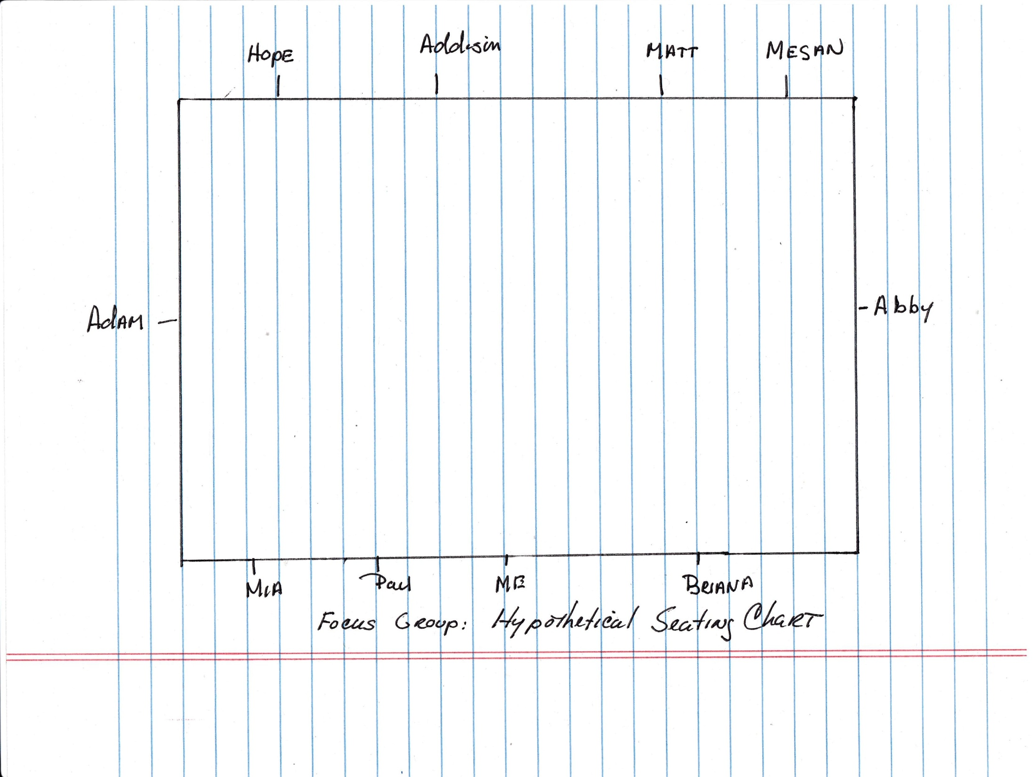
Insert Seating Chart here
Notes:
As you can see from the image, the seating chart is not fancy. I hand draw it at the site of the focus group reflecting the shape of the table; and I handwrite the participant’s names as he or she introduces him or herself. Writing down each name helps me remember it. I will ask a person to spell his or her name if it seems out of the ordinary or if I did not hear it well. This chart is placed in front of me along with my facilitator's hand book as I conduct the focus group. I think it takes the edge off of the introductions and warms up the room. I introduce myself as well and I am answer the ice breaking too to facilitate a collegial atmosphere.
(As an aside, notice also that I placed myself in the middle of the table not at the head or foot; in the middle will give the best sound recording and I don’t want to assume the power position at either end of the table. This chart is only used for my notes; the introductions will help with voice recognition during the discussion; and it serves as a head count (male and female if names are gender specific).

Slide 14
Remember a Person’s Name
“Learn your butcher’s name, (s)he is your ally. “ And in so doing you will help forge a relationship where the butcher may tell you about a recent shipment, suggest a particular cut of meat or provide preparation hints and help you plan a meal for family and/or friends.
Mario Batali (American chief, writer and restaurateur) , The Chew
September 24, 2012

Slide 15
Talk in Terms of the Other Person’s Interest
This example comes from a follow-up email planned to be sent to participants in a study, who had not completed their survey:
Original Wording……
Two weeks ago we asked you to participate in a survey sponsored by [name of organization and funder]. If you completed the survey, thank you very much. We appreciate the time and thought you put into your responses. You may disregard the remainder of this e-mail.
For those of you who did not respond, we are writing to let you know that we have extended the deadline to [specific date]. We would like to give you more time to participate in this opportunity and increase the number of responses to this survey.
Notes:
This was a survey distributed to government administrators and potential vendors focused on gathering feedback about reforms that had been made to the RFP process to obtain specific government services. The purpose of the survey was to learn about whether recent reforms actually had been put in place and to what degree those affected by theses reforms were aware of their implementation.
Not sure if the appeal to help improve our response rate would have appeal to our participants. We cared about this but not sure they did. These folks were administrators who were extremely busy and likely to be motivated to see and implement change and likely frustrated to varying degrees about the status-quo of the RFP process.

Slide 16
Talk in Terms of the Other Person’s Interest
Revised Wording……
Two weeks ago we asked you to participate in a survey sponsored by[name of organization and funder]. If you completed the survey, please disregard the remainder of this e-mail and thank you very much. We appreciate the time and thought you put into your responses. You may disregard the remainder of this e-mail.
For those of you who did not respond, we are writing to let you know that we have extended the deadline to [specific date]. We hope that you will take advantage of this opportunity to participate so that we can ensure that your experiences are reflected in our findings. We would like to give you more time to participate in this opportunity and increase the number of responses to this survey.
Notes:
Okay so it may not be “creating an eager want” but it is an appeal that may likely resonant with participants – an attempt to talk in terms of the interests of these participants as we were discussing the impact of given reforms which were in various stages of being implemented and reforms these participants were participating in; make sure that the appeal is genuine -- don’t over sell as this could have a reverse effect if the appeal is not perceived to be genuine. Thus, we tried to talk in terms that the other person could relate to or appealed to something that they had a vested interested in.
Actually, we got a nice little boost in our response rate after this follow-up email.

Slide 17
Forming Professional Relationships
Carnegie suggests that empathy and respect are key to forming collaborations and
professional relationships
And I am suggesting that these are needed to facilitate and/or sustain evaluation efforts
Notes:
Again not as an advocate but treating others as respected colleagues.

Slide 18
Collaboration
Here is what Susan Labin and others (2012) said about the importance of collaboration in Evaluation Capacity Building.
In their synthesis of the ECB literature:

Slide 19
Collaboration
Collaboration emerged as the essential thread in the fabric of ECB (Evaluation Capacity Building) efforts, warranting its explicit inclusion as a key concept in ECB models, efforts, and evaluations.
Labin, S. N., Duffy, J. L., Meyers, D. D.., Wandersman, A. & Lesesne, C. A. (2012). A synthesis of
the evaluation capacity building literature. American Journal of Evaluation, 33(3), 307- 338

Slide 20
Collaboration
Collaborative issues and participatory processes involve the ways in which people interact and can be considered part of the human relations of ECB.
Labin, S. N., Duffy, J. L., Meyers, D. D.., Wandersman, A. & Lesesne, C. A. (2012). A synthesis of
the evaluation capacity building literature. American Journal of Evaluation, 33(3), 307- 338
Notes:
Based on a research synthesis of the evaluation capacity building literature

Slide 21
From the Profound …
To act intelligently in human affairs is only possible if an attempt is made to understand the thoughts, motives, and apprehensions of one’s opponent so fully that one can see the world through his eyes.
Albert Einstein, Essays in Humanism, 1950.
Einstein, A. (1950). A reply to the Soviet scientists. In A. Einstein, Essays in humanism.
New York: Open Road Integrated Media.

Slide 22
….To the Everyday
In business, the alliances you form are incredibly important. .. They carry you through the mistakes you make. That is as important as the creative process itself.
Joanna Coles, Project Runway All Stars: After Runway Show, March 8, 2012.

Slide 23
What Dale Carnegie’s Principles Suggest for Evaluation
Kathryn Race
Race & Associates, Ltd.
4430 N. Winchester Ave
Chicago, IL
American Evaluation Association Annual Conference Minneapolis, MN
October 24-27, 2012
race_associates@msn.com

